Slide 1
Unconstrained Ear Recognition on ResMLP
Marwin B. Alejo
2020-20221

Slide 2
Background/Motivation
Unconstrained Ear Recognition on ResMLP
Exotic and budding field of biometry;
Ears have great advantage in passive biometry than other traits;
Lits are scarce on (a) dataset and (b) fusion on recent computational techniques;
Most papers suggested the use of (1) image processing tchnqs or (2) CNNs;
(1) is laborious while (2) is computationally expensive – prone to overfitting because of (a).

Slide 3
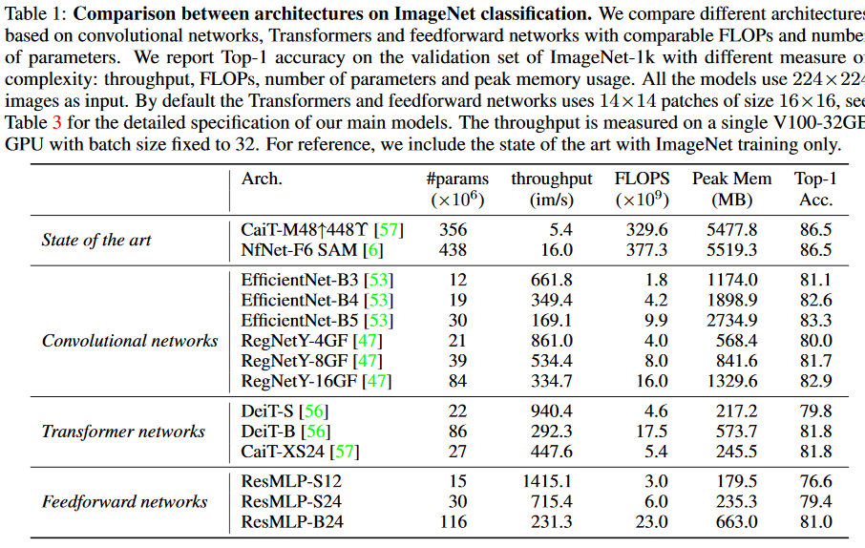
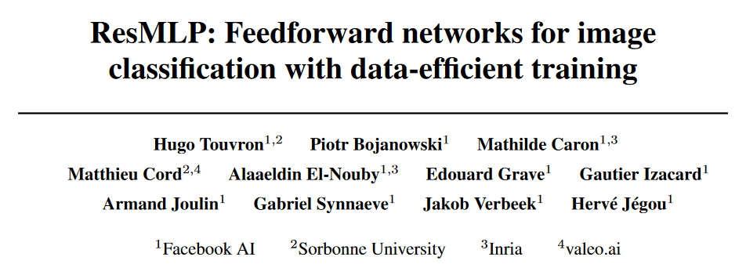
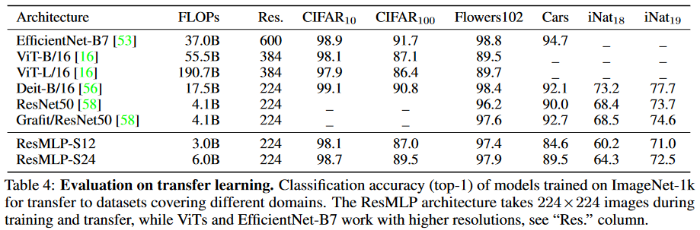
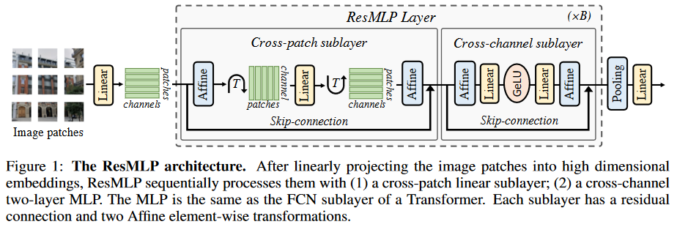
Proposed Solution (diagrams are tentative)
Unconstrained Ear Recognition on ResMLP

Slide 4
Technicalities and Output
Unconstrained Ear Recognition on ResMLP
EarVN1.0 dataset (available in Mendeley
164 person; 28412 ear images in the wild
Google Colaboratory
PyTorch1.10 and other secret ingredients (libraries)
Outputs:
Documentation
Modeling Scripts

